Slide 1

SMS Spam detection using NLP
Name: Vaishnavi Kainthola
Section: B1
Roll No: 76
Mini Project

Slide 2

INTRODUCTION
SMS spam detection involves identifying unwanted or malicious messages using machine learning or rule-based systems.
It enhances user experience by filtering spam, employing techniques like natural language processing and statistical analysis.

Slide 3
OBJECTIVE
Develop an accurate and efficient SMS/email spam detection model using machine learning.
Create an intuitive user interface for real-time email classification.

Slide 4
METHODOLOGY
The model utilizes a labeled dataset of emails, where messages are categorized as spam or ham.
Preprocessing involves cleaning text data and vectorizing it using CountVectorizer.
The core classifier is a Multinomial Naive Bayes model, trained on an 80/20 train-test split for optimal performance.
The model is then integrated with a Tkinter-based GUI and Streamlit-based web app, allowing users to classify emails online.

Slide 5

Multinomial Naive Bayes Model
This is the core machine learning model used for classification.
The Multinomial Naive Bayes algorithm is well-suited for text data and is based on Bayes' Theorem with an assumption of independence between features.
The model uses preprocessed numerical data to learn patterns associated with spam and non-spam (ham) messages.

Slide 6
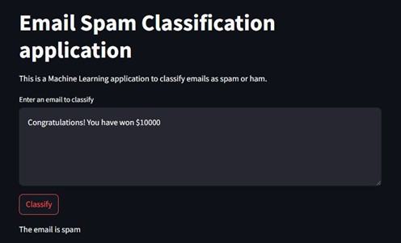
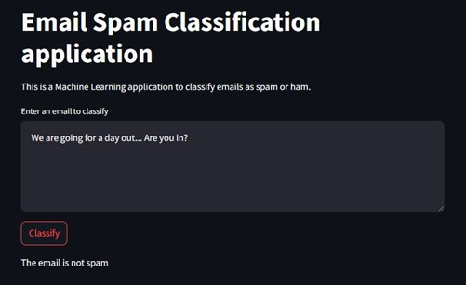
OUTPUT
After training the model, it classifies the email as either spam or ham based on its learned patterns.
SPAM MAIL
NOT SPAM MAIL

Slide 7
Applications
Email Service Providers: Enhance email filtering systems for platforms like Gmail, Outlook, and Yahoo Mail.
Enterprise Solutions: Help businesses safeguard against phishing and spam, improving security and productivity.
Individual Users: Provide tools for better email management, saving time and reducing frustration.
Cybersecurity: Detect malicious emails, protecting users from fraud, malware, and data breaches.
Education and Awareness: Serve as a learning tool for understanding machine learning applications in text classification.

Slide 8

CHALLENGES AND FUTURE WORK
Content-Based Classification Only: The model relies solely on the email’s text content and does not consider metadata like sender information or email headers.
Language Dependency: The model may not perform well with emails written in languages not present in the training dataset.
Generalization: Performance depends on the dataset used for training. It may need retraining for different datasets or evolving spam patterns.
Limited Context Understanding: It cannot identify advanced spam techniques, such as image-based spam or context-specific phishing attempts.
Real-Time Processing: While suitable for moderate volumes, handling extremely large-scale email datasets might require additional computational resources.

Slide 9

CONCLUSION
The SMS Spam Detection Model employs NLP and machine learning to classify emails as "spam" or "ham."
Using CountVectorizer for text preprocessing and a Multinomial Naive Bayes classifier, it provides accurate predictions.
The model features both a GUI built with Tkinter and a user-friendly web interface via Streamlit, where users can input emails for classification.
Voice feedback enhances the desktop experience, while the Streamlit app ensures a seamless online user experience, making it versatile and interactive.

Slide 10
THANK YOU!

